Slide 1
Machine Learning : Basic
2016.00.00(월)
박지현

Slide 2
Introduction
Linear Regression
Logistic Regression
Regularization
Neural Networks
Advices for Machine Learning
Unsupervised Learning
Anomaly Detection

Slide 3
Introduction
Linear Regression
Logistic Regression
Regularization
Neural Networks
Advices for Machine Learning
Unsupervised Learning
Anomaly Detection

Slide 4
Introduction
=
상세 내용
What is Machine Learning
Easy Answer
Machine Learning은 컴퓨터에게 사람이 직접 명시적으로 Logic을 지시하지 않아도 데이터를 통해 컴퓨터가 ‘학습’을 하고 그것을 사용해 컴퓨터가 자동으로 문제를 해결하도록하는 것을 의미
Deep Answer
Machine Learning이 하는 일은 주어진 ‘데이터’ X=(x1,x2,x3,…,xn)와 각 데이터에 대응하는 실제 ‘현상’ Y=(y1,y2,…,yn)에 대한 ‘관계’ function f를 찾는 과정
정확한 함수 f를 찾기 위해 Machine Learning 알고리즘들은 데이터에 대한 가정을 하고, 그 가정에 따라 주어진 데이터를 ‘최대한 잘 설명할 수 있는’, 함수 f′을 찾는다. 이때 이런 f′을 Hypothesis라고 함

Slide 5
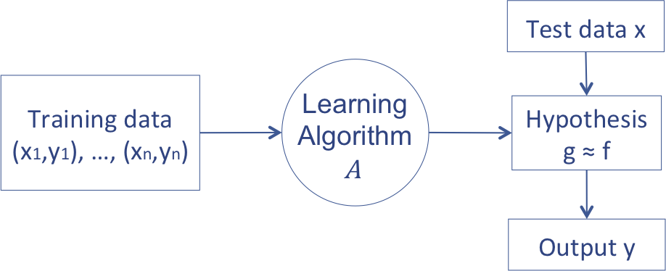
Introduction
=
상세 내용
Basic Concept of Machine Learning
Unknown target function f:X→Y
Input: Set of possible instance(domain): X
Output: Y
Set of hypothesis function space H⊂{h|h:X→Y}
Input
Training example {⟨xi,yi⟩} : (training set)
Output
h∈H that best approximates target function f with some performance measure

Slide 6
Introduction
=
상세 내용
Class of Machine Learning
Machine Learning
Supervised Learning
Unsupervised Learning
Reinforcement
Learning
<Task Driven>
Regression
Classification
<Data Driven>
Clustering
<Algorithm learns to
react to an environment>

Slide 7
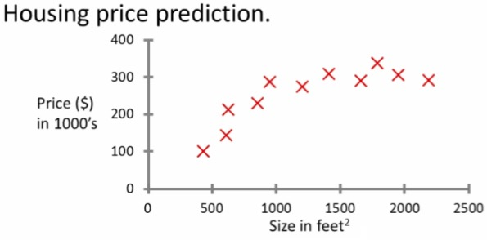
Introduction
=
상세 내용
Supervised learning - introduction : regression problem
Example problem: "Given this data, a friend has a house 750 square feet - how much can they be expected to get?”
The idea is we can learn what makes the price a certain value from the training data
The algorithm should then produce more right answers based on new training data where we don't know the price already.

Slide 8
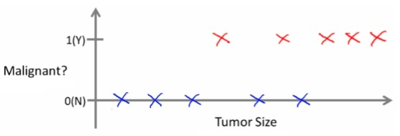
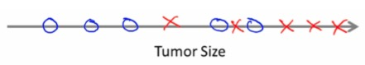
Introduction
=
상세 내용
Supervised learning - classification
Example problem: " Can we definer breast cancer as malignant or benign based on tumor size?”
Classify data into one of two discrete classes - no in between, either malignant or not
In classification problems, can have a discrete number of possible values for the output

Slide 9
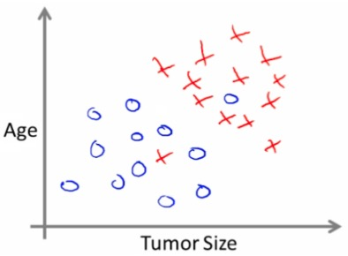
Introduction
=
상세 내용
Supervised learning - classification
Use only one attribute (size)
In other problems may have multiple attributes
We may also, for example, know age and tumor size

Slide 10
Introduction
=
상세 내용
Unsupervised learning - introduction : Clustering algorithm
In unsupervised learning, we get unlabeled data
Just told - here is a data set, can you structure it
One way of doing this would be to cluster data into to groups
This is a clustering algorithm
Example of clustering algorithm
Google news
Groups news stories into cohesive groups
Social network analysis
Customer data
Run algorithm to cluster individuals into types of people
Basically,
Can a machine automatically generate structure?
Because we don't give it the answer, it's unsupervised learning

Slide 11
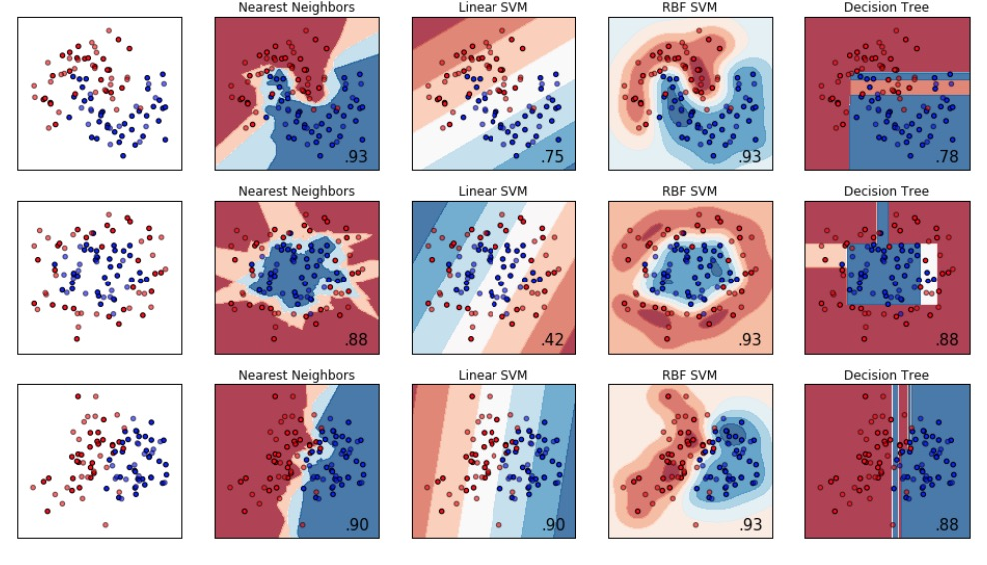
Introduction
=
상세 내용
Unsupervised learning - introduction : Clustering algorithm

Slide 12
Introduction
Linear Regression
Logistic Regression
Regularization
Neural Networks
Advices for Machine Learning
Unsupervised Learning
Anomaly Detection

Slide 13
Linear Regression
=
상세 내용
Linear Regression
Housing price data example used earlier
Supervised learning regression problem
What do we start with?
Training set (this is your data set)➔labeled datasets
Notation (used throughout the course)
m = number of training examples
x's = input variables / features
y's = output variable "target" variables
(x,y) - single training example
(xi, yj) - specific example (i_th training example)
i is an index to training set

Slide 14
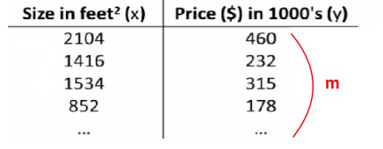
Linear Regression
=
상세 내용
Linear Regression

Slide 15
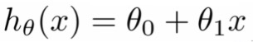
Linear Regression
=
상세 내용
Linear Regression
With our training set defined - how do we used it?
Take training set
Pass into a learning algorithm
Algorithm outputs a function (denoted h ) (h = hypothesis)
This function takes an input (e.g. size of new house)
Tries to output the estimated value of Y
How do we represent hypothesis h ?
Going to present h as; (θi are parameters)
So in summary
A hypothesis takes in some variable
Uses parameters determined by a learning system
Outputs a prediction based on that input

Slide 16
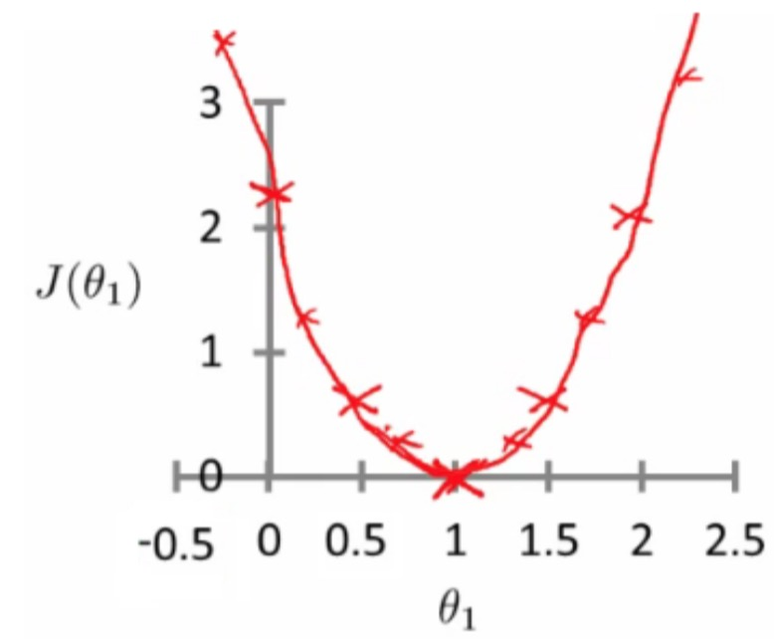
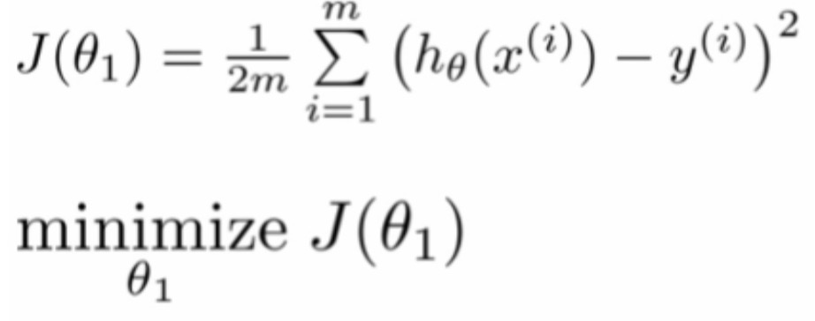
Linear Regression
=
상세 내용
Linear regression - implementation (cost function)
A cost function lets us figure out how to fit the best straight line to our data
Think of h_{θ}(x) as a "y imitator"
it tries to convert the x into y, and considering we already have y we can evaluate how well h_{θ}(x) does this
The optimization objective for the learning algorithm is find the value of θ₁ which minimizes J(θ₁)

Slide 17
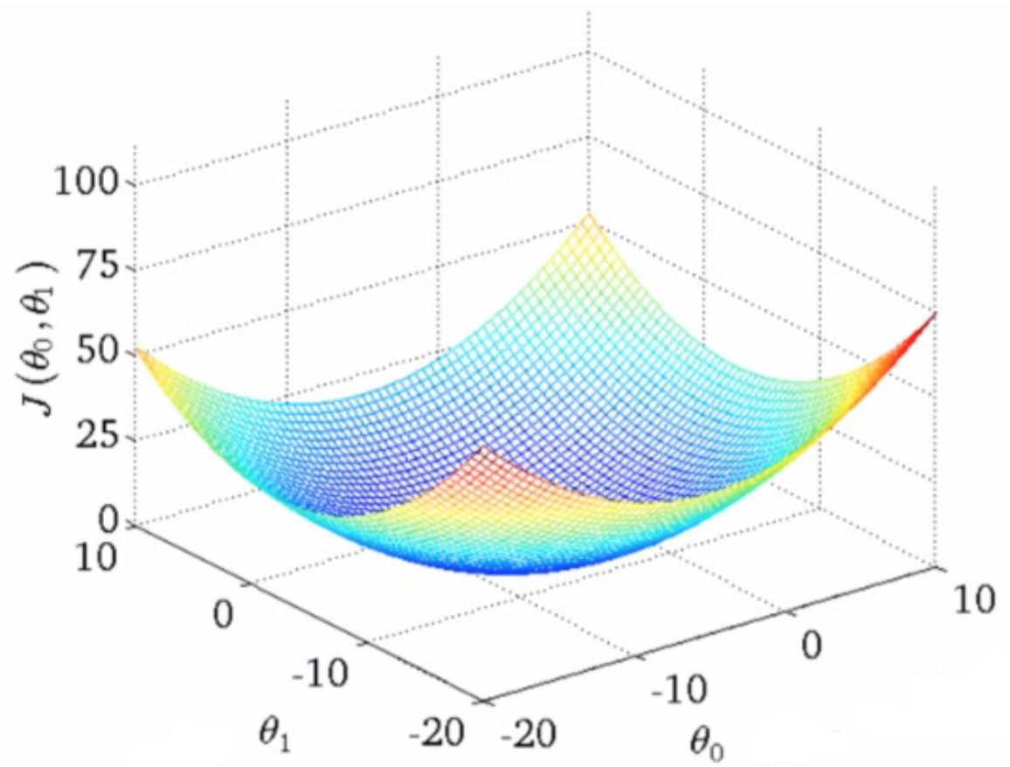
Linear Regression
=
상세 내용
A deeper insight into the cost function

Slide 18
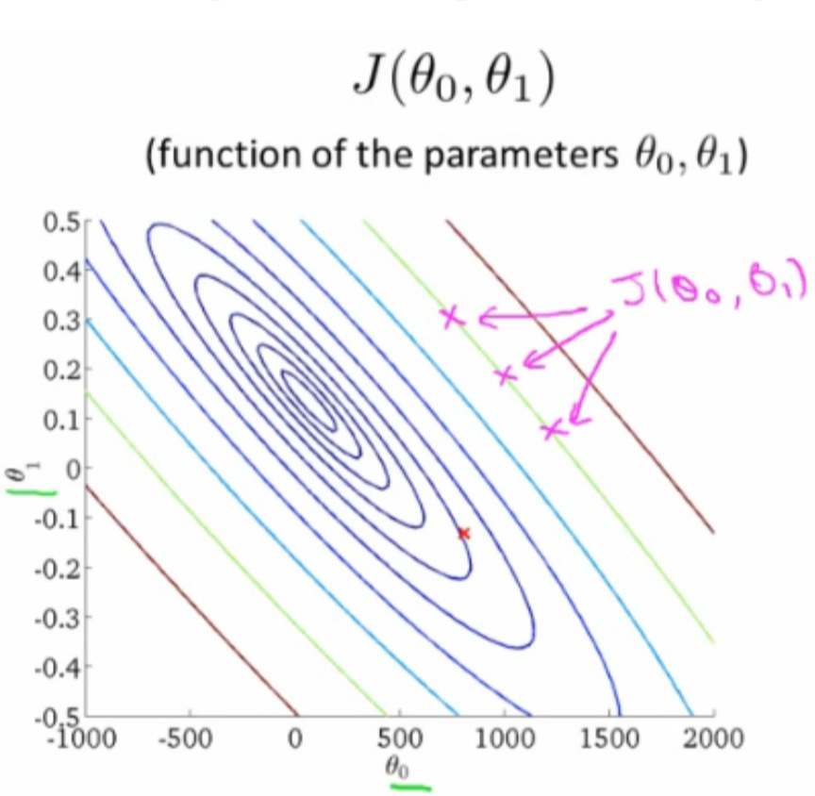
Linear Regression
=
상세 내용
A deeper insight into the cost function

Slide 19
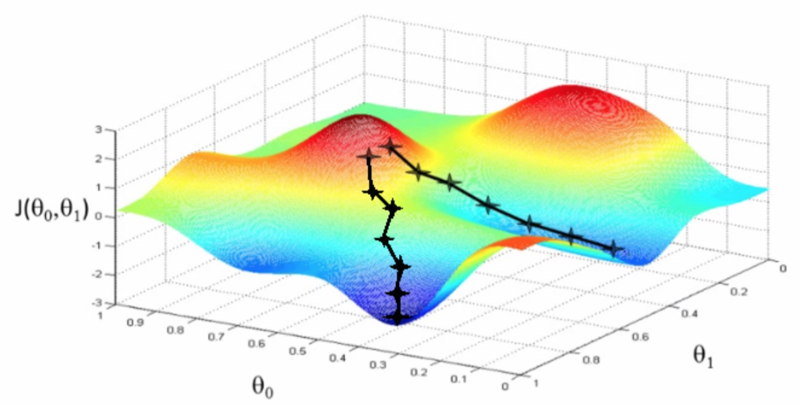
Linear Regression
=
상세 내용
Gradient descent algorithm
Minimize cost function J
Gradient descent
Used all over machine learning for minimization

Slide 20
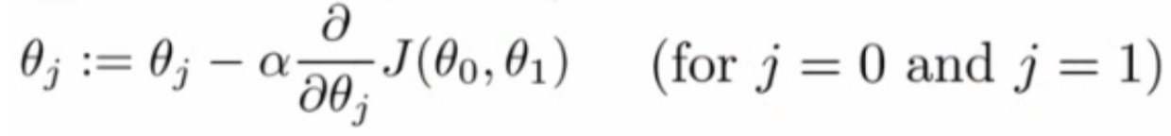
Linear Regression
=
상세 내용
Gradient descent algorithm
Formal definition
Do the following until convergence
The linear regression cost function is always a convex function ➔ always has a single minimum

Slide 21
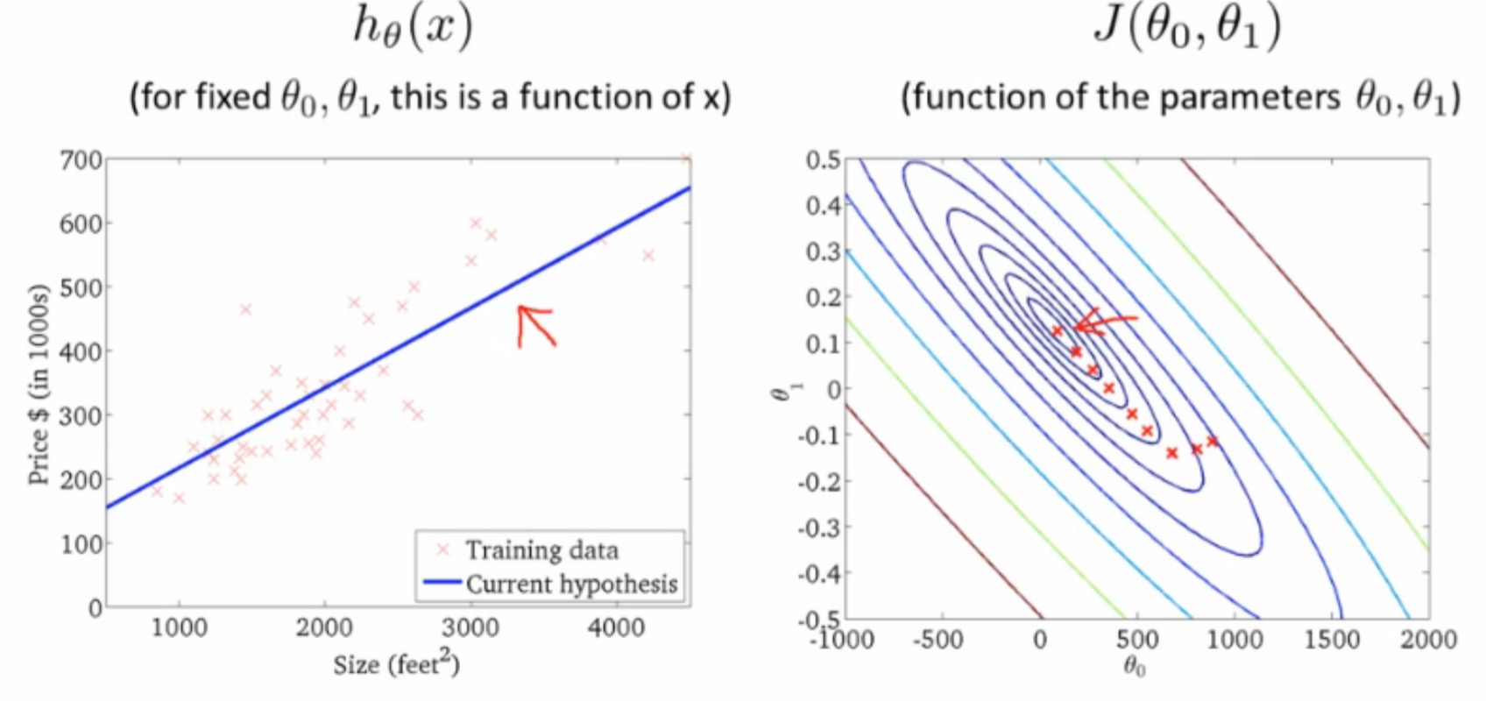
Linear Regression
=
상세 내용
Gradient descent for multiple variables

Slide 22
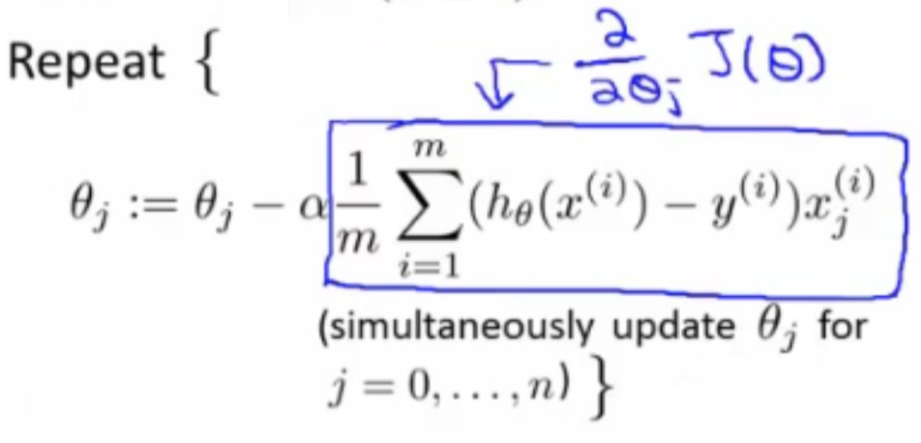
Linear Regression
=
상세 내용
Gradient descent for multiple variables
This is actually Batch Gradient Descent
Refers to the fact that over each step you look at all the training data

Slide 23
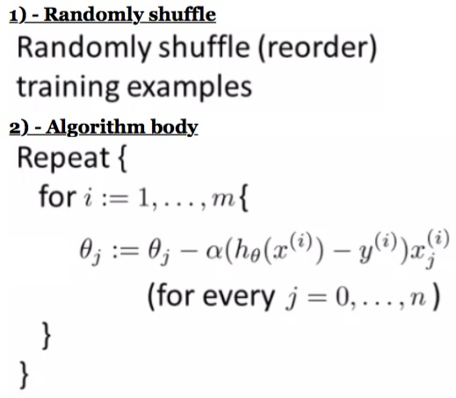
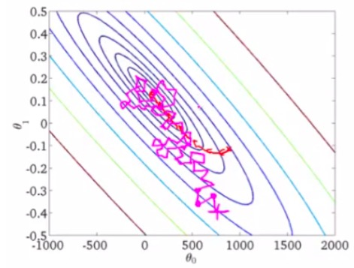
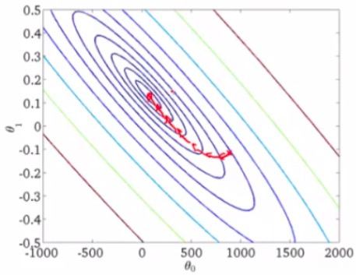
Linear Regression
=
상세 내용
Stochastic Gradient Descent (SGD)

Slide 24
Linear Regression
=
상세 내용
Mini Batch Gradient Descent
Mini-batch gradient descent is an additional approach which can work even faster than stochastic gradient descent
To summarize our approaches so far
Batch gradient descent: Use all m examples in each iteration
Stochastic gradient descent: Use 1 example in each iteration
Mini-batch gradient descent: Use b examples in each iteration
b = mini-batch size
So just like batch, except we use tiny batches
Typical range for b = 2-100 (10 maybe) For example
b = 10
Get 10 examples from training set
Perform gradient descent update using the ten examples

Slide 25
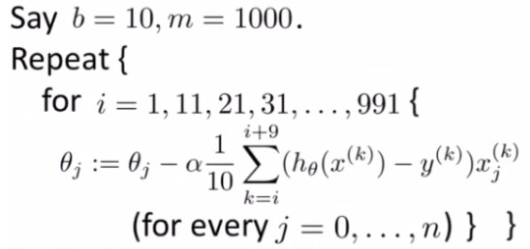
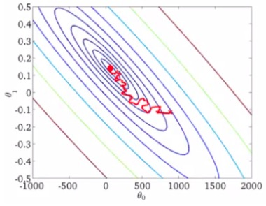
Linear Regression
=
상세 내용
Mini Batch Gradient Descent
Mini-batch algorithm

Slide 26
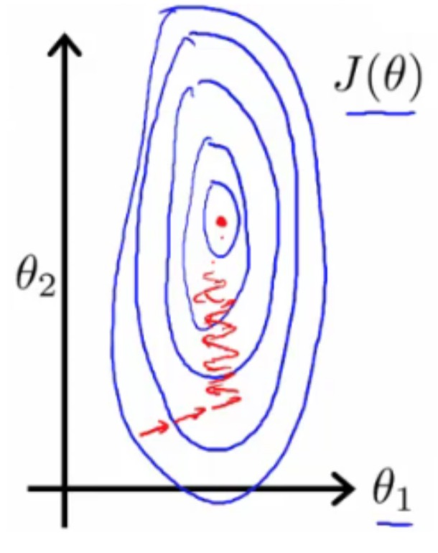
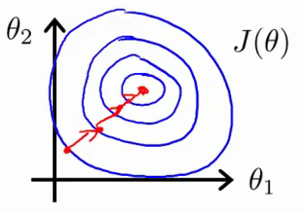
Linear Regression
=
상세 내용
Gradient Decent in practice 1: Feature Scaling

Slide 27
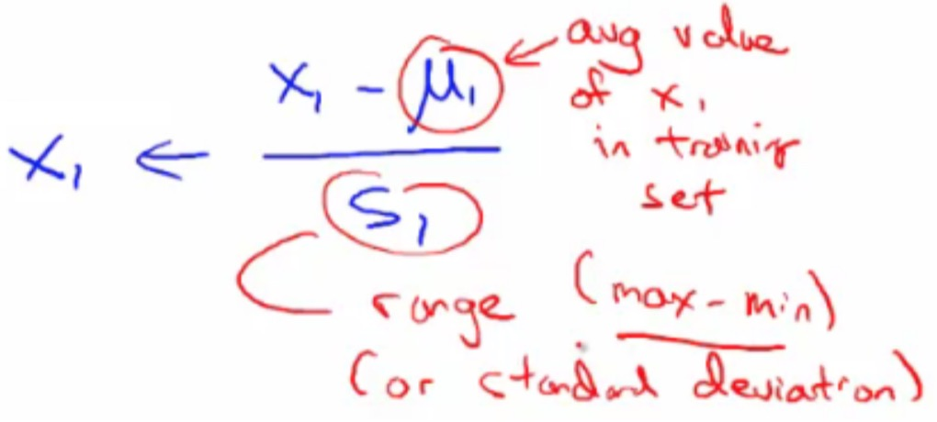
Linear Regression
=
상세 내용
Gradient Decent in practice 1: Feature Scaling
Mean normalization
Take a feature xi
Replace it by (xi - mean)/max
So your values all have an average of about 0

Slide 28
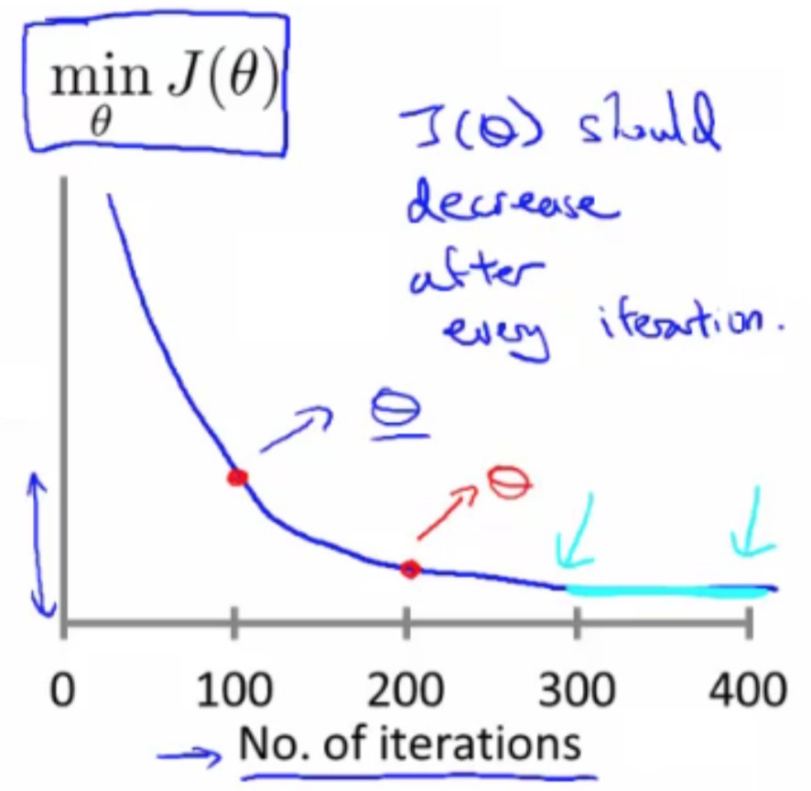
Linear Regression
=
상세 내용
Gradient Decent in practice 2: Learning Rate α
Plot min J(θ) vs. no of iterations (i.e. plotting J(θ) over the course of gradient descent
If gradient descent is working then J(θ) should decrease after every iteration;

Slide 29
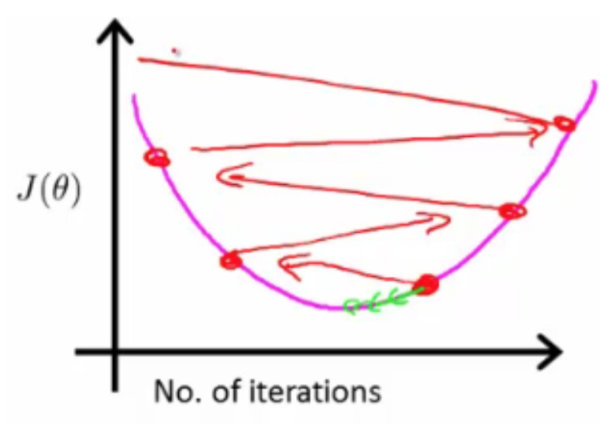
Linear Regression
=
상세 내용
Gradient Decent in practice 2: Learning Rate α
If you plot J(θ) vs iterations and see the value is increasing
means you probably need a smaller α
Cause is because your minimizing a function which looks like this;

Slide 30
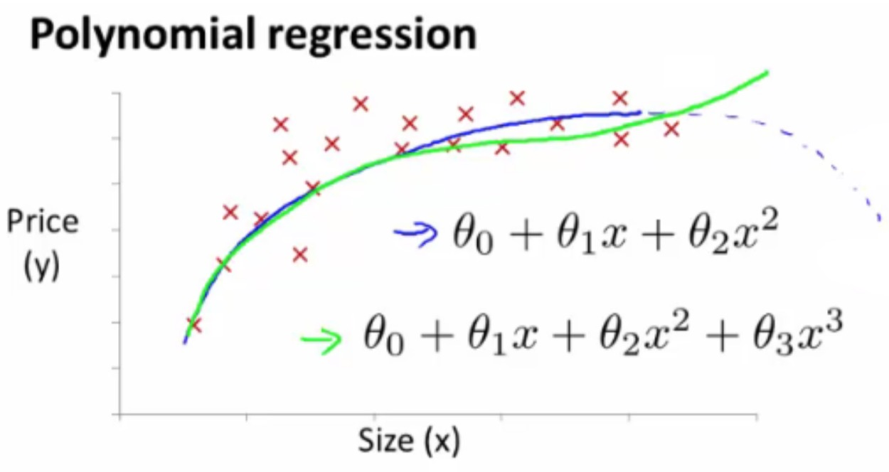
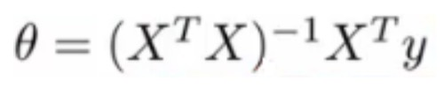
Linear Regression
=
상세 내용
Features and polynomial regression
the derivation is pretty complex...
Normal Equation
allows us to get optimal parameter without derivation

Slide 31
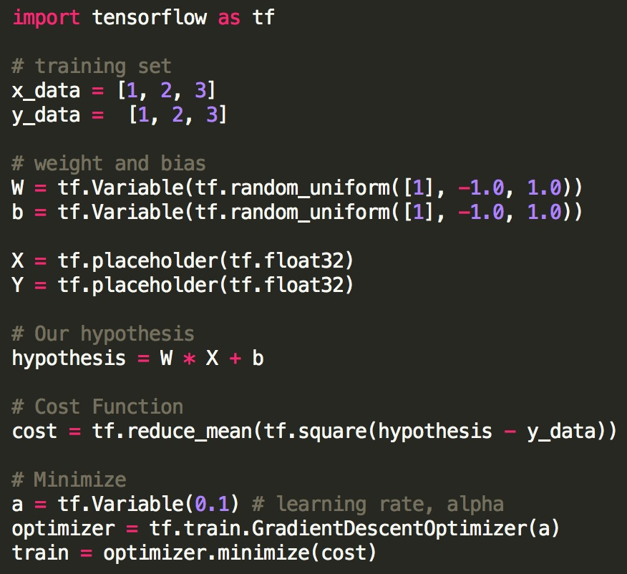
Linear Regression
=
상세 내용
Tensorflow linear regression

Slide 32
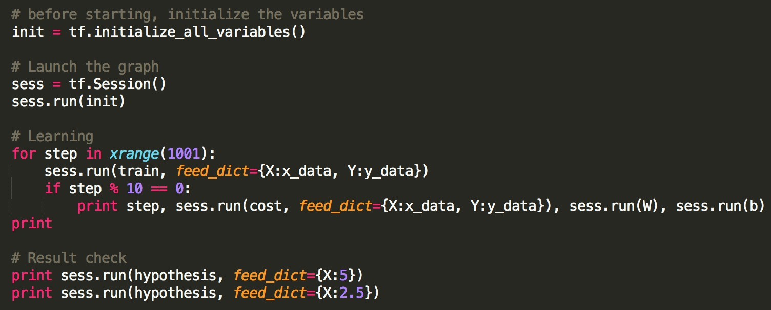
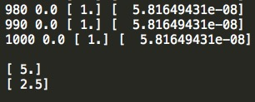
Linear Regression
=
상세 내용
Tensorflow linear regression

Slide 33
Introduction
Linear Regression
Logistic Regression
Regularization
Neural Networks
Advices for Machine Learning
Unsupervised Learning
Anomaly Detection

Slide 34
Logistic Regression
=
상세 내용
Logistic Regression
Where y is a discrete value
Classification problems
Email -> spam/not spam?
Online transactions -> fraudulent?
Tumor -> Malignant/benign
Variable in these problems is Y Y is either 0 or 1
0 = negative class (absence of something)
1 = positive class (presence of something)
Start with binary class problems
Later look at multiclass classification problem, although this is just an extension of binary classification

Slide 35
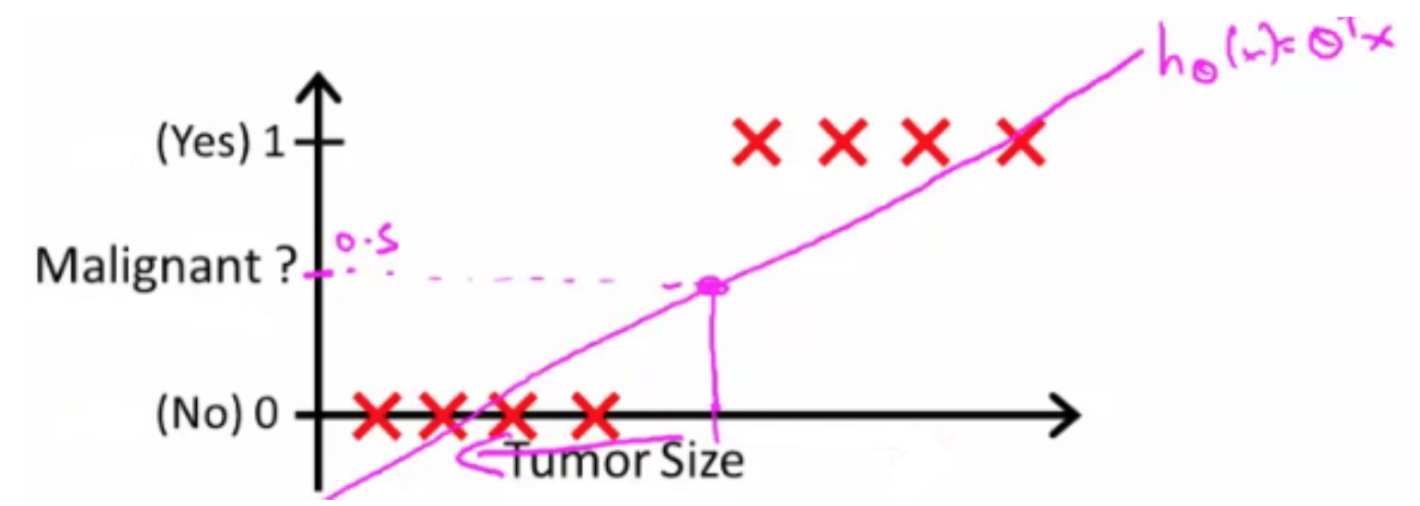
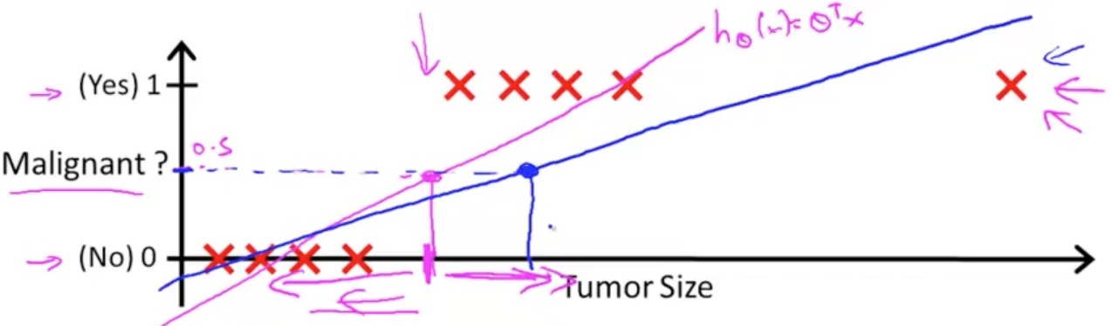
Logistic Regression
=
상세 내용
Logistic Regression

Slide 36
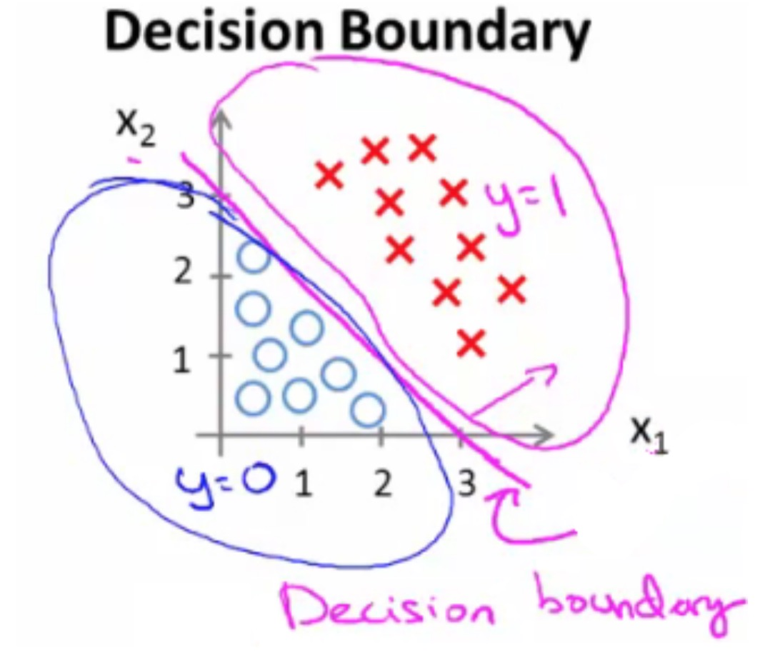
Logistic Regression
=
상세 내용
Logistic Regression
Decision boundary

Slide 37
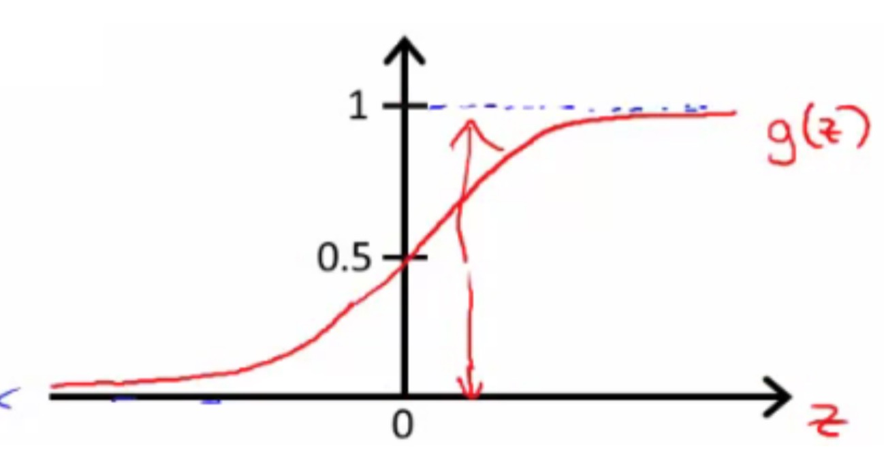
Logistic Regression
=
상세 내용
Logistic Regression
Sigmoid function
For classification hypothesis representation, ➔ we do h_{θ}(x) = g((θ^{T} x))
Where we define g(z), z is a real number
g(z) = 1/(1 + e^{(-z)})
This is the sigmoid function, or the logistic function

Slide 38
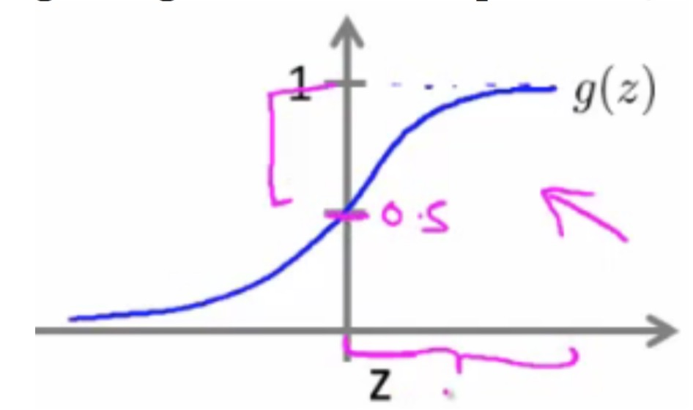
Logistic Regression
=
상세 내용
Logistic Regression
Hypothesis representation = “Sigmoid function” + “Decision boundary”
hθ(x) = g((θ^{T} x))
θ^{T} x ➔ Decision Boundary
hθ(x) = P(y=1|x ; θ)
What does this mean?
Probability that y=1, given x, parameterized by θ

Slide 39
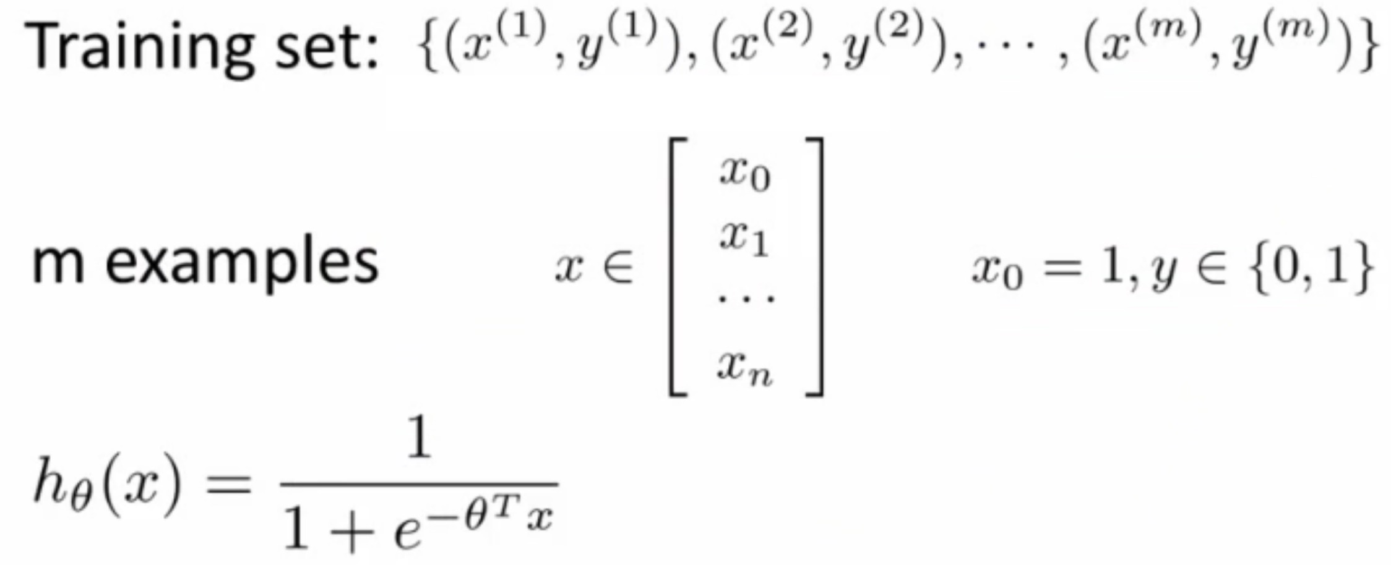
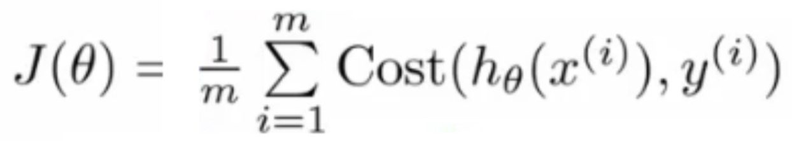
Logistic Regression
=
상세 내용
Cost function for logistic regression

Slide 40
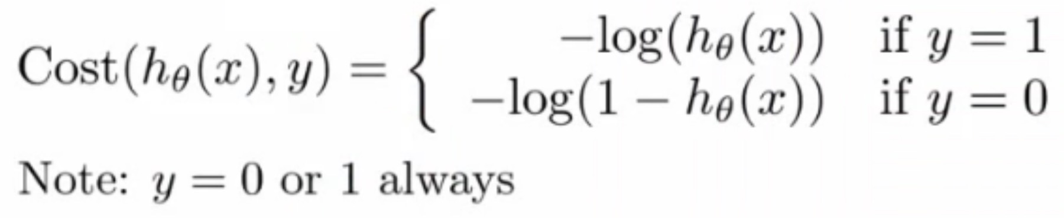
Logistic Regression
=
상세 내용
Cost function for logistic regression
If we use the cost function, which is from linear regression, for logistic regression this is a non-convex function for parameter optimization
Our hypothesis function has a non-linearity (sigmoid function of h_{θ}(x) )
A convex logistic regression cost function
To get around this we need a different, convex Cost() function which means we can apply gradient descent

Slide 41
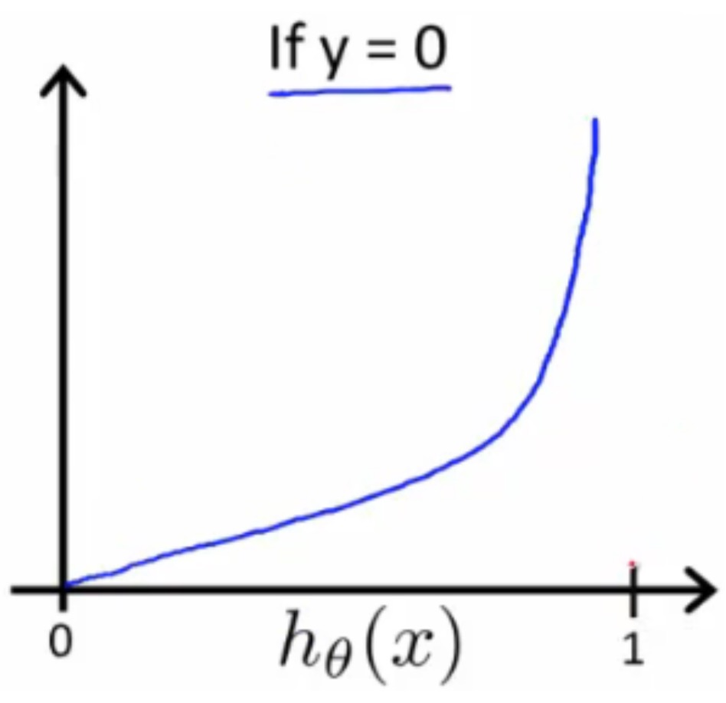
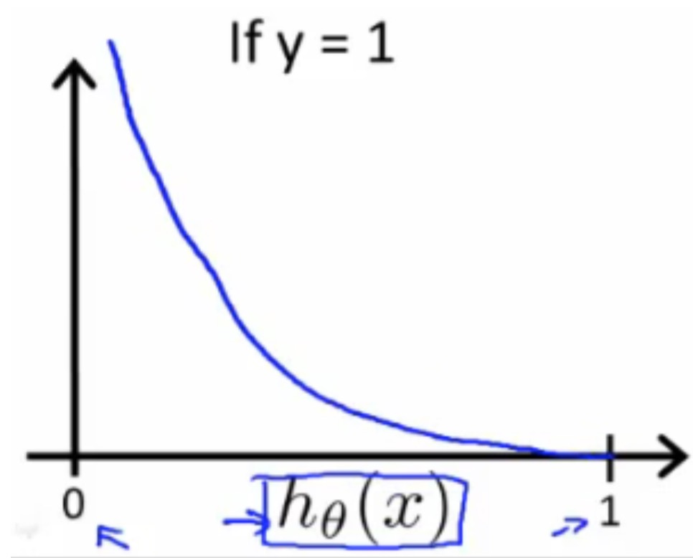
Logistic Regression
=
상세 내용
Cost function for logistic regression

Slide 42
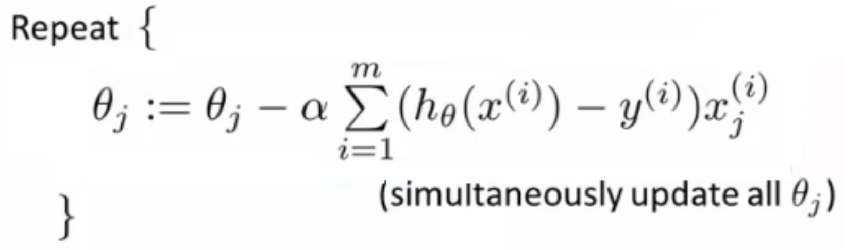
Logistic Regression
=
상세 내용
How to minimize the logistic regression cost function

Slide 43
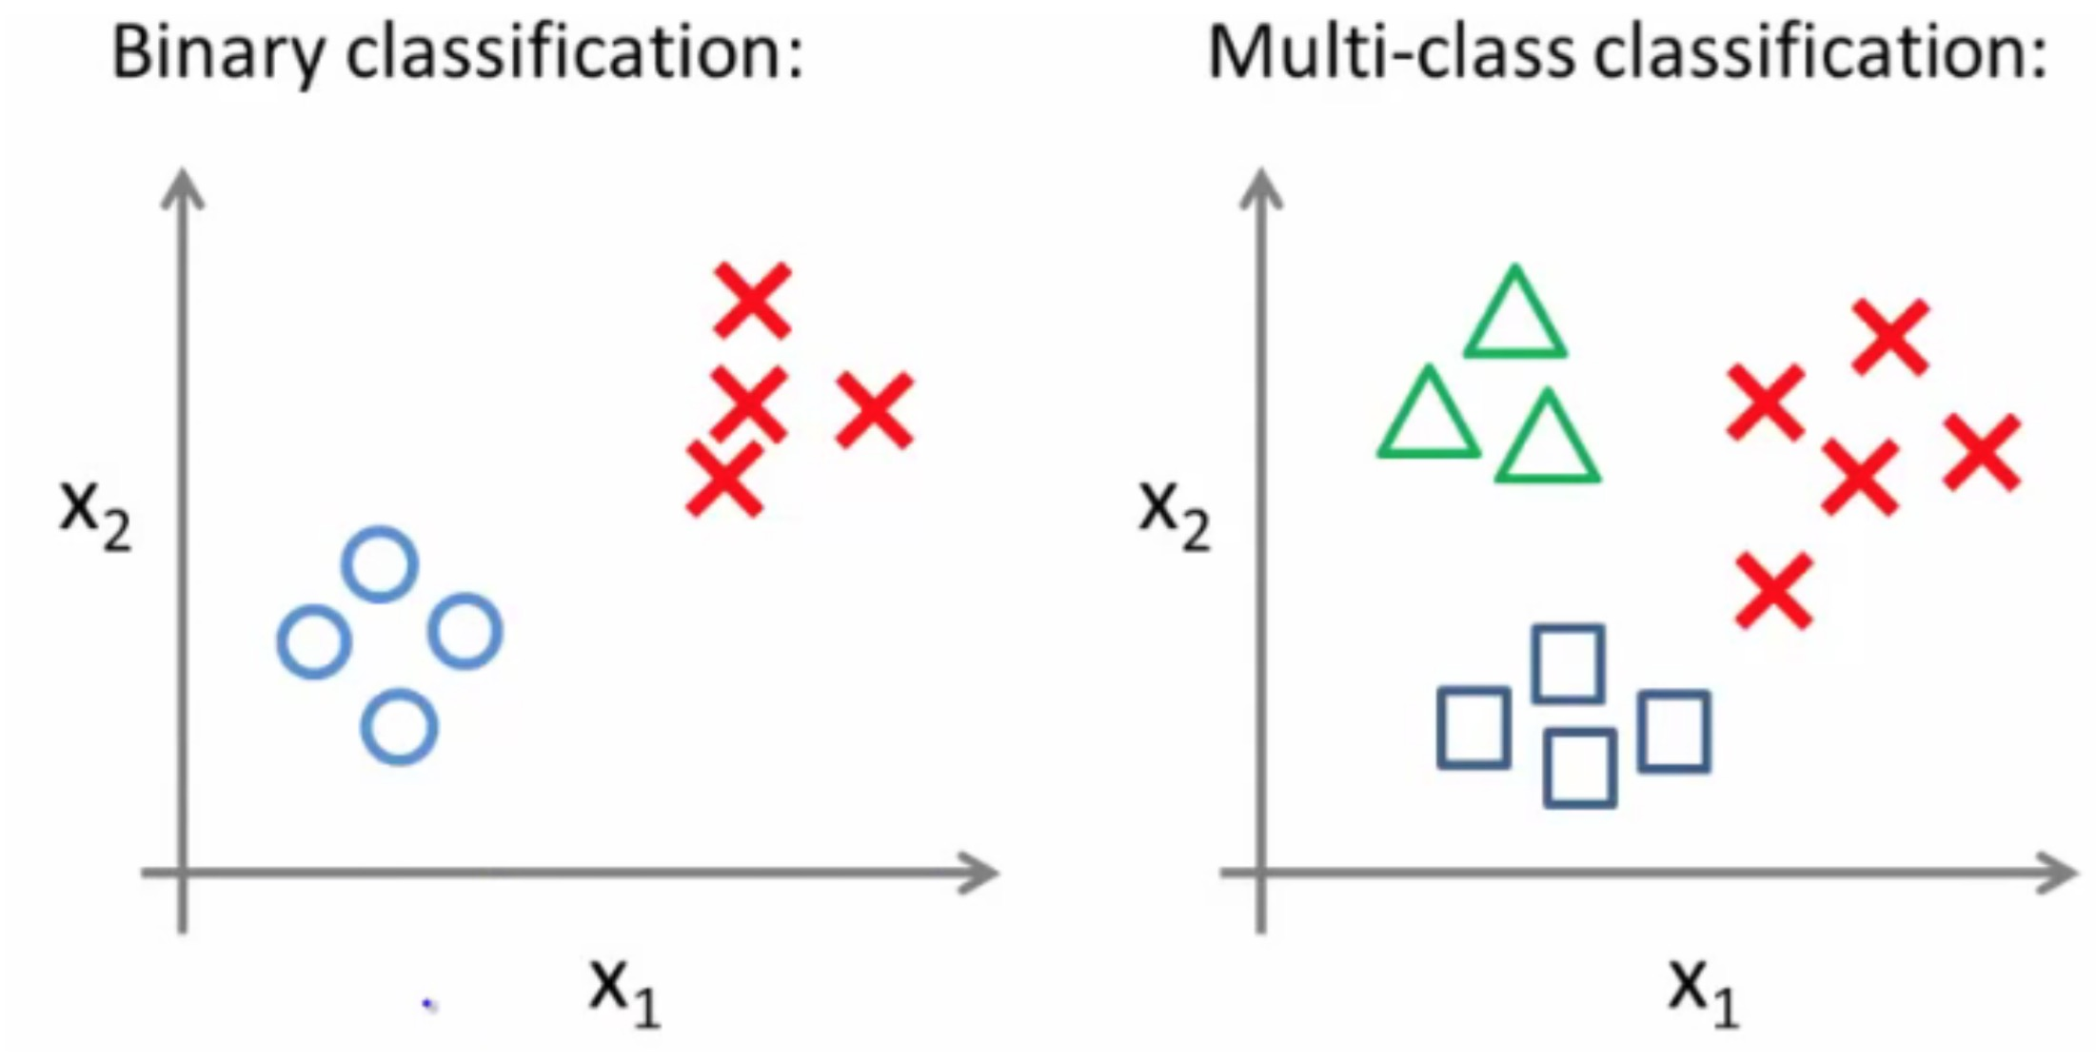
Logistic Regression
=
상세 내용
Multiclass classification problems
Getting logistic regression for multiclass classification using one vs. all
Multiclass - more than yes or no (1 or 0)
Classification with multiple classes for assignment

Slide 44
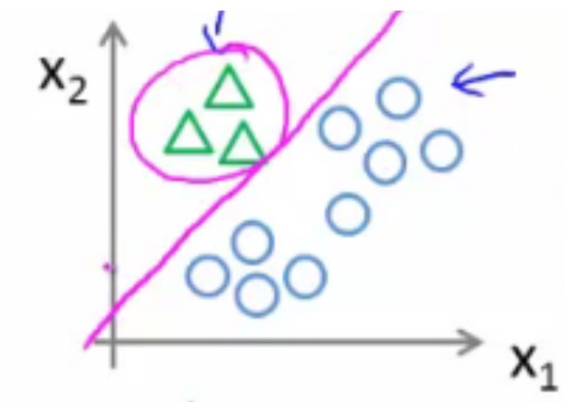
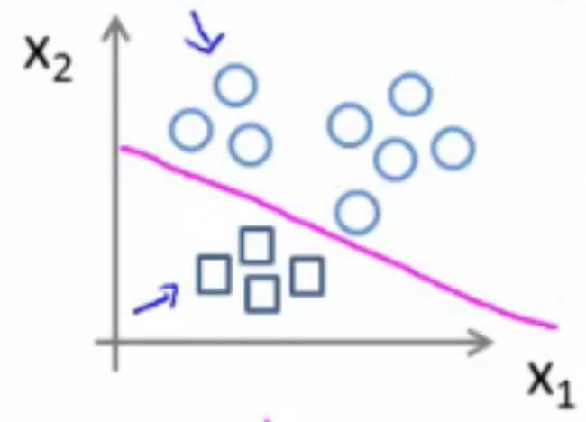
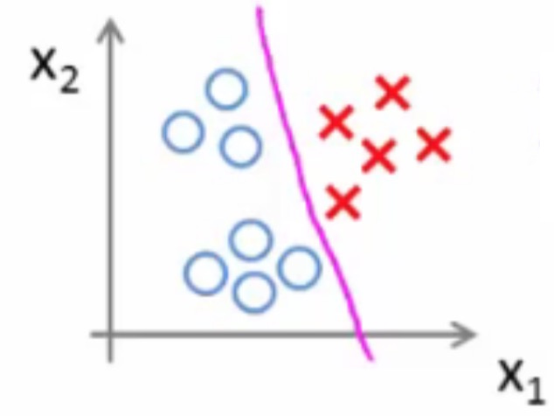
Logistic Regression
=
상세 내용
Multiclass classification problems
One vs. all classification
Split the training set into three separate binary classification problems i.e. create a new fake training set
Triangle (1) vs crosses and squares (0): hθ1(x) P(y=1 | x1; θ)
Crosses (1) vs triangle and square (0): hθ2(x) P(y=1 | x2; θ)
Square (1) vs crosses and square (0): hθ3(x) P(y=1 | x3; θ)

Slide 45
Introduction
Linear Regression
Logistic Regression
Regularization
Neural Networks
Advices for Machine Learning
Unsupervised Learning
Anomaly Detection

Slide 46
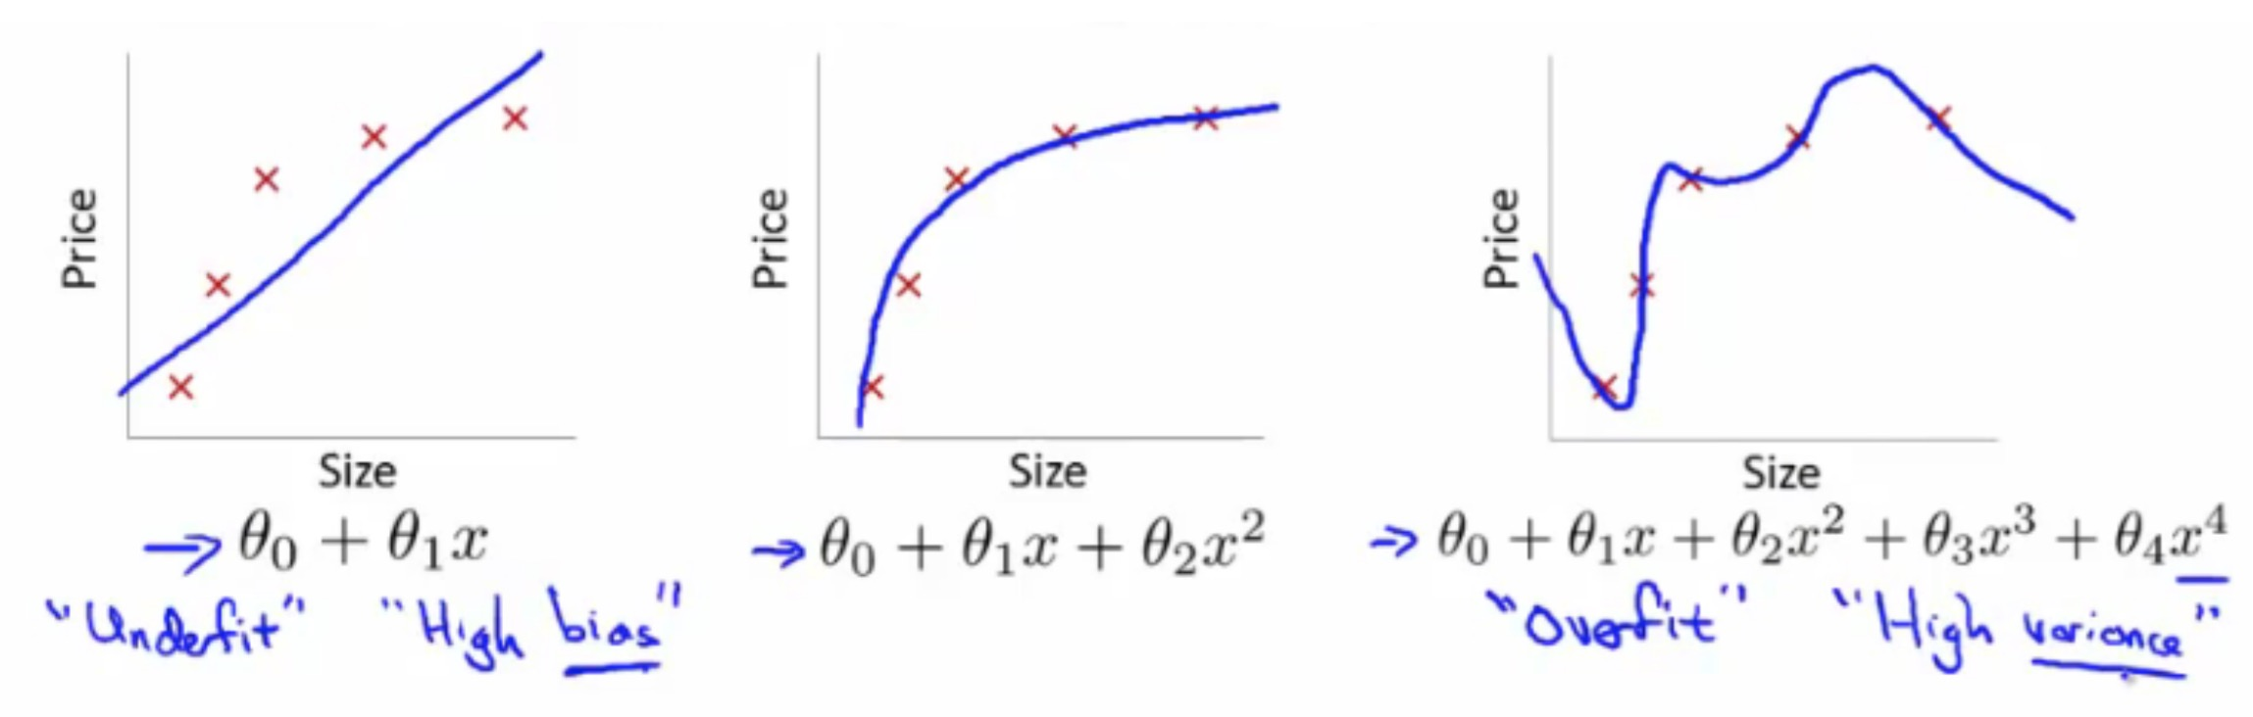
Regularization
=
상세 내용
Regularization
The problem of overfitting
underfitting - also known as high bias
overfitting - also known as high variance
Fails to provide a general solution - unable to generalize (apply to new examples)
Overfitting with linear regression

Slide 47
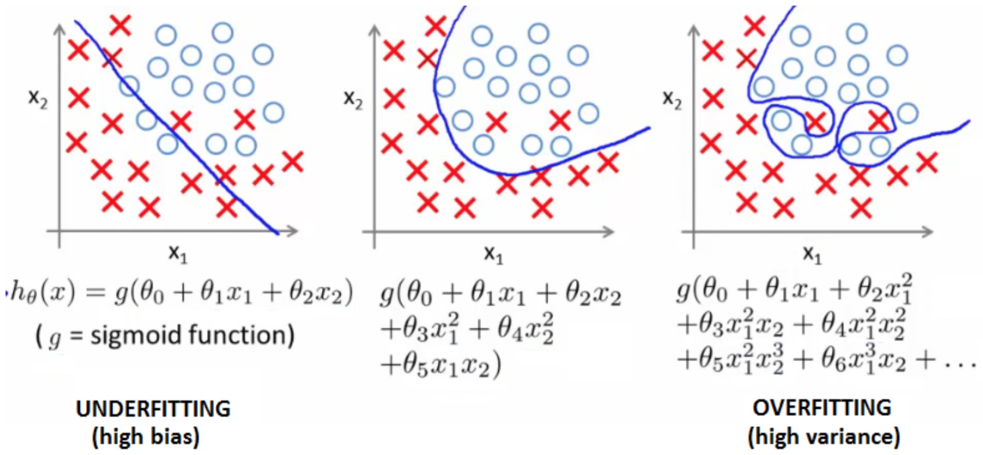
Regularization
=
상세 내용
Regularization
Overfitting with logistic regression

Slide 48
Regularization
=
상세 내용
Regularization
How do we deal with this?
Reduce number of features
Manually select which features to keep
Model selection algorithms are discussed later (good for reducing number of features)
But, in reducing the number of features we lose some information
Ideally select those features which minimize data loss, but even so, some info is lost
Regularization
Keep all features, but reduce magnitude of parameters θ
Works well when we have a lot of features, each of which contributes a bit to predicting y

Slide 49
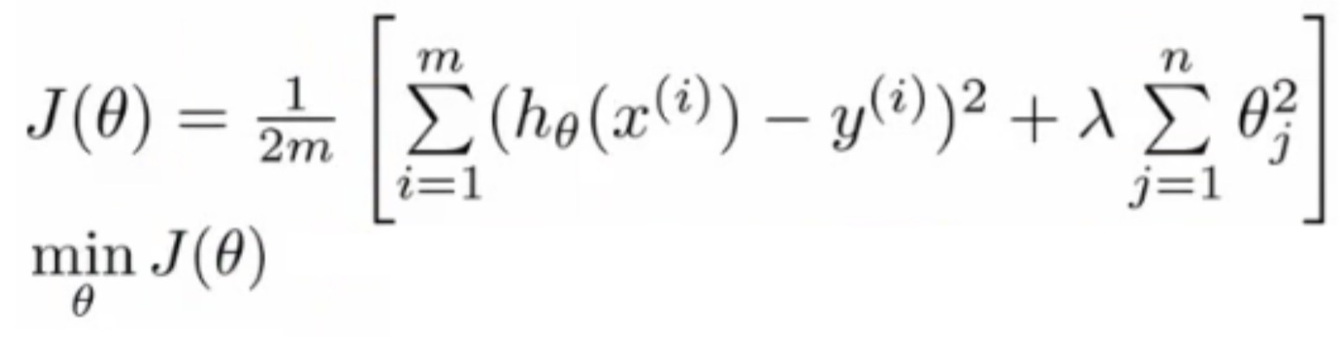
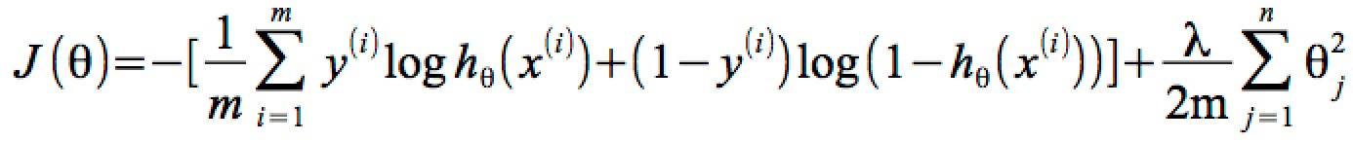
Regularization
=
상세 내용
Regularization
Regularization for linear regression
Penalty term
Regularization for logistic regression
Penalty term

Slide 50
Introduction
Linear Regression
Logistic Regression
Regularization
Neural Networks
Advices for Machine Learning
Unsupervised Learning
Anomaly Detection

Slide 51


Neural Networks
=
상세 내용
Neural Networks
Why do we need neural networks?
Say we have a complex supervised learning classification problem

Slide 52

Neural Networks
=
상세 내용
Neural Networks
Why do we need neural networks?
Problems where n is large - computer vision
Need a non-linear hypothesis to separate the classes
Feature space
If we used 50 x 50 pixels → 2500 pixels, so n = 2500

Slide 53

Neural Networks
=
상세 내용
Model representation

Slide 54


Neural Networks
=
상세 내용
Model representation
Perceptron ➔ Neural Network

Slide 55

Neural Networks
=
상세 내용
Neural Networks
First layer is the input layer
Final layer is the output layer
produces value computed by a hypothesis
Middle layer(s) are called the hidden layers
You don't observe the values processed in the hidden layer
Not a great name
Can have many hidden layers

Slide 56

Neural Networks
=
상세 내용
Neural networks - notation
a_{i}^{(j)} - activation of unit i in layer j
So, a₁² is the activation of the 1st unit in the second layer
By activation, we mean the value which is computed and output by that node
Ɵ^{(j)} - matrix of parameters controlling the function mapping from layer j to layer j + 1

Slide 57

Neural Networks
=
상세 내용
Model representation
Forward propagation

Slide 58

Neural Networks
=
상세 내용
Neural network example
computing a complex, nonlinear function of the input
Non-linear classification: XOR/XNOR
x1, x2 are binary

Slide 59

Neural Networks
=
상세 내용
Neural network example
computing a complex, nonlinear function of the input

Slide 60

Neural Networks
=
상세 내용
Multiclass classification
Recognizing pedestrian, car, motorbike or truck
Build a neural network with four output units
Output a vector of four numbers
1 is 0/1 pedestrian
2 is 0/1 car
3 is 0/1 motorcycle
4 is 0/1 truck

Slide 61


Neural Networks
=
상세 내용
Neural network cost function
The (regularized) logistic regression cost function is as follows;
For neural networks our cost function is a generalization of this equation above, so instead of one output we generate k outputs;

Slide 62

Neural Networks
=
상세 내용
Back propagation algorithm
Algorithm used to minimize the cost function, as it allows us to calculate partial derivatives!

Slide 63



Neural Networks
=
상세 내용
Tensorflow MNIST – Set up the Model

Slide 64




Neural Networks
=
상세 내용
Tensorflow MNIST – Set up the Model

Slide 65

Neural Networks
=
상세 내용
Tensorflow MNIST – Learning

Slide 66

Neural Networks
=
상세 내용
Tensorflow MNIST – Test & Validate
https://github.com/jhyun0919/ML-DL_jhyun/blob/master/TensorFlow_jhyun/mist_basic_practice.ipynb

Slide 67
Introduction
Linear Regression
Logistic Regression
Regularization
Neural Networks
Advices for Machine Learning
Unsupervised Learning
Anomaly Detection

Slide 68

Advices for ML
=
상세 내용
Evaluating a hypothesis - generalization
Standard way to evaluate a hypothesis is
Split data into two portions
1st portion is training set
2nd portion is test set

Slide 69

Advices for ML
=
상세 내용
Model selection and training validation test sets
Model selection problem
Try to chose the degree for a polynomial to fit data
d = what degree of polynomial do you want to pick
Take these parameters and look at the test set error for each using the previous formula
J_{test}(θ¹)
J_{test}(θ²)
...
J_{test}(θ¹⁰)

Slide 70
Advices for ML
=
상세 내용
Model selection and training validation test sets
Say, for example, d=5 is the lowest
Now take the d=5 model and say, how well does it generalize?
You could use J_{test}(θ⁵)
BUT, this is going to be an optimistic estimate of generalization error, because our parameter is fit to that test set (i.e. specifically chose it because the test set error is small)
So not a good way to evaluate if it will generalize
Improved model selection
Given a training set instead split into three pieces
1 - Training set (60%) - m values
2 - Cross validation (CV) set (20%) m_{cv}
3 - Test set (20%) m_{test}

Slide 71

Advices for ML
=
상세 내용
Model selection and training validation test sets
Minimize cost function for each of the models as before
Test these hypothesis on the cross validation set to generate the cross validation error
Pick the hypothesis with the lowest cross validation error
e.g. pick θ₅
Finally, estimate generalization error of model using the test set

Slide 72

Advices for ML
=
상세 내용
Diagnosis - bias vs. variance
If you get bad results usually because of one of
High bias - under fitting problem
High variance - over fitting problem

Slide 73

Advices for ML
=
상세 내용
Diagnosis - bias vs. variance
For the high bias case, we find both cross validation and training error are high
Doesn't fit training data well
Doesn't generalize either
For high variance, we find the cross validation error is high but training error is low
Training set fits well
But generalizes poorly

Slide 74


Advices for ML
=
상세 내용
Regularization and bias/variance

Slide 75
Introduction
Linear Regression
Logistic Regression
Regularization
Neural Networks
Advices for Machine Learning
Unsupervised Learning
Anomaly Detection

Slide 76
Unsupervised Learning
상세 내용
Unsupervised learning
Talk about clustering
Learning from unlabeled data
Unsupervised learning
Useful to contras with supervised learning
Compare and contrast
Supervised learning
Given a set of labels, fit a hypothesis to it
Unsupervised learning
Try and determining structure in the data
Clustering algorithm groups data together based on data features
What is clustering good for
Market segmentation - group customers into different market segments
Social network analysis - Facebook "smart lists”
Organizing computer clusters and data centers for network layout and location
Astronomical data analysis - Understanding galaxy formation

Slide 77

Unsupervised Learning
상세 내용
Clustering
K-means algorithm
Want an algorithm to automatically group the data into coherent clusters
K-means is by far the most widely used clustering algorithm

Slide 78
Unsupervised Learning
상세 내용
Clustering
Step 1: Randomly allocate two points as the cluster centroids
Have as many cluster centroids as clusters you want to do (K cluster centroids, in fact)
In our example we just have two clusters
Step 2: Cluster assignment step
Go through each example and depending on if it's closer to the red or blue centroid assign each point to one of the two clusters
To demonstrate this, we've gone through the data and "colour" each point red or blue
Step 3: Move centroid step
Take each centroid and move to the average of the correspondingly assigned data-points

Slide 79


Unsupervised Learning
상세 내용

Slide 80

Unsupervised Learning
상세 내용
Clustering
Input:
K (number of clusters in the data)
Training set {x1, x2, x3 ..., xn)
Algorithm:
Randomly initialize K cluster centroids as {μ1, μ2, μ3 ... μK}
Loop 1
This inner loop repeatedly sets the c(i) variable to be the index of the closes variable of cluster centroid closes to xi
i.e. take i th example, measure squared distance to each cluster centroid, assign c(i) to the cluster closest
Loop 2
Loops over each centroid calculate the average mean based on all the points associated with each centroid from c(i)

Slide 81

Unsupervised Learning
상세 내용
Clustering
K-means for non-separated clusters
So far looking at K-means where we have well defined clusters But often K-means is applied to datasets where there are not well defined clusters
e.g. T-shirt sizing

Slide 82

Unsupervised Learning
상세 내용
Clustering
So creates three clusters, even though they aren't really there
Look at first population of people
Try and design a small T-shirt which fits the 1st population
And so on for the other two This is an example of market segmentation
Build products which suit the needs of your subpopulations

Slide 83


Unsupervised Learning
상세 내용
Clustering - K means optimization objective
Supervised learning algorithms have an optimization objective
cost function
K-means does too
K-means has an optimization objective like the supervised learning functions we've seen
Why is this good?
Knowing this is useful because it helps for debugging
Helps find better clusters
Using this notation we can write the optimization objective;

Slide 84
Unsupervised Learning
상세 내용
Clustering - K means optimization objective
If we consider the k-means algorithm
The cluster assigned step is minimizing J(...) with respect to c1, c2 ... ci
i.e. find the centroid closest to each example
Doesn't change the centroids themselves
The move centroid step
We can show this step is choosing the values of μ which minimizes J(...) with respect to μ

Slide 85
Unsupervised Learning
상세 내용
Clustering - Random initialization
How we initialize K-means
And how avoid local optimum
Consider clustering algorithm
Never spoke about how we initialize the centroids
A few ways - one method is most recommended
Have number of centroids set to less than number of examples (K < m, if K > m we have a problem)
Randomly pick K training examples
Set μ1 up to μK to these example's values
K means can converge to different solutions depending on the initialization setup
Risk of local optimum

Slide 86

Unsupervised Learning
상세 내용
Clustering - Random initialization
If this is a concern
We can do multiple random initializations
See if we get the same result - many same results are likely to indicate a global optimum

Slide 87

Unsupervised Learning
상세 내용
Clustering - Random initialization
Algorithmically we can do this as follows;
A typical number of times to initialize K-means is 50-1000
Randomly initialize K-means
For each 100 random initialization run K-means
Then compute the distortion on the set of cluster assignments and centroids at convergent
End with 100 ways of cluster the data
Pick the clustering which gave the lowest distortion

Slide 88
Unsupervised Learning
상세 내용
Clustering
How do we choose the number of clusters?
Choosing K?
Not a great way to do this automatically
Normally use visualizations to do it manually
Why is this hard
Sometimes very ambiguous
e.g. two clusters or four clusters
Not necessarily a correct answer
This is why doing it automatic this is hard
Elbow method
Vary K and compute cost function at a range of K values
As K increases J(...) minimum value should decrease (i.e. you decrease the granularity so centroids can better optimize)

Slide 89

Unsupervised Learning
상세 내용
Clustering - Elbow method
Chose the "elbow" number of clusters
If you get a nice plot this is a reasonable way of choosing K
Risks
Normally you don't get a a nice line → no clear elbow on curve
Not really that helpful

Slide 90

Unsupervised Learning
상세 내용
Clustering - Another method for choosing K
Using K-means for market segmentation
Running K-means for a later/downstream purpose
See how well different number of clusters serve you later needs
e.g.
T-shirt size example
If you have three sizes (S,M,L)
Or five sizes (XS, S, M, L, XL)
Run K means where K = 3 and K = 5

Slide 91

Unsupervised Learning
상세 내용
Other ways to do Clustering

Slide 92
Introduction
Linear Regression
Logistic Regression
Regularization
Neural Networks
Advices for Machine Learning
Unsupervised Learning
Anomaly Detection

Slide 93

Anomaly Detection
상세 내용
Anomaly detection - problem motivation
Anomaly detection is a reasonably commonly used type of machine learning application
Can be thought of as a solution to an unsupervised learning problem
But, has aspects of supervised learning
What is anomaly detection?
Imagine you're an aircraft engine manufacturer
As engines roll off your assembly line you're doing QA
Measure some features from engines (e.g. heat generated and vibration)

Slide 94


Anomaly Detection
상세 내용
Anomaly detection - problem motivation
You now have a dataset of x¹ to x^{m} (i.e. m engines were tested)
Say we plot that dataset
We have a dataset which contains normal (data)
How we ensure they're normal is up to us
In reality it's OK if there are a few which aren't actually normal
Using that dataset as a reference point we can see if other examples are anomalous

Slide 95

Anomaly Detection
상세 내용
Anomaly detection - problem motivation
How do we do this?
First, using our training dataset we build a model
We can access this model using p(x)
This asks, "What is the probability that example x is normal"
Having built a model
if p(x_{test}) < ε → flag this as an anomaly
if p(x_{test}) >= ε → this is OK
ε is some threshold probability value which we define, depending on how sure we need/want to be

Slide 96
Anomaly Detection
상세 내용
Anomaly detection - problem motivation
Applications
Fraud detection
Users have activity associated with them, such as
Length on time on-line
Location of login
Spending frequency
Using this data we can build a model of what normal users' activity is like
Monitoring computers in data center
If you have many machines in a cluster
Computer features of machine
x1 = memory use
x2 = number of disk accesses/sec
x3 = CPU load
x4 = CPU load/network traffic

Slide 97
Anomaly Detection
상세 내용
The Gaussian distribution (optional)
Also called the normal distribution
Say x (data set) is made up of real numbers
Mean is μ
Variance is σ^2 σ is also called the standard deviation - specifies the width of the Gaussian probability
The data has a Gaussian distribution
Then we can write this ~ N(μ,σ^2 )
~ means = is distributed as
N (should really be "script" N (even curlier!) -> means normal distribution
μ, σ^2 represent the mean and variance, respectively
These are the two parameters a Gaussian means

Slide 98


Anomaly Detection
상세 내용
The Gaussian distribution (optional)
Gaussian equation is
P(x : μ , σ^2) (probability of x, parameterized by the mean and squared variance)

Slide 99
Anomaly Detection
상세 내용
Anomaly detection algorithm
Unlabeled training set of m examples
Data = {x¹, x², ..., x^{m} }
Each example is an n-dimensional vector (i.e. a feature vector)
We have n features!
Model P(x) from the data set
What are high probability features and low probability features
x is a vector
So model p(x) as = p(x₁; μ₁ , σ₁^2) * p(x₂; μ₂ , σ₂^2) * ... * p(x_{n} ; μ_{n} , σ_{n}^2)
Multiply the probability of each features by each feature
We model each of the features by assuming each feature is distributed according to a Gaussian distribution
p(x_{i}; μ_{i} , σ_{i}^2)
The probability of feature x_{i} given μ_{i} and σ_{i}^2, using a Gaussian distribution

Slide 100

Anomaly Detection
상세 내용
Anomaly detection algorithm

Slide 101


Anomaly Detection
상세 내용
Anomaly detection example
x1
Mean is about 5
Standard deviation looks to be about 2
x2
Mean is about 3
Standard deviation about 1

Slide 102

Anomaly Detection
상세 내용
Anomaly detection example
Check if a value is anomalous
Set epsilon as some value
Say we have two new data points new data-point has the values
x₁_test
x₂_test
We compute
p(x₁_test) = 0.436 >= epsilon (~40% chance it's normal) Normal
p(x₂_test) = 0.0021 < epsilon (~0.2% chance it's normal) Anomalous

Slide 103
Anomaly Detection
상세 내용
Developing and evaluating and anomaly detection system
Assume we have some labeled data
So far we've been treating anomalous detection with unlabeled data
If you have labeled data allows evaluation
i.e. if you think something is anomalous you can be sure if it is or not
So, taking our engine example
You have some labeled data
Data for engines which were non-anomalous → y = 0
Data for engines which were anomalous → y = 1
Training set is the collection of normal examples
OK even if we have a few anomalous data examples
Next define
Cross validation set
Test set

Slide 104
Anomaly Detection
상세 내용
Developing and evaluating and anomaly detection system
Specific example
Engines
Have 10,000 good engines
OK even if a few bad ones are here...
LOTS of y = 0
20 flawed engines
Typically when y = 1 have 2-50
Split into
Training set: 6,000 good engines (y = 0)
CV set: 2,000 good engines, 10 anomalous
Test set: 2,000 good engines, 10 anomalous
Ratio is 3:1:1

Slide 105
Anomaly Detection
상세 내용
Anomaly detection vs. Supervised learning
Anomaly detection
Very small number of positive examples
Not enough data to "learn" positive examples
Have a very large number of negative examples
Use these negative examples for p(x) fitting
Only need negative examples for this
Many "types" of anomalies
Hard for an algorithm to learn from positive examples when anomalies may look nothing like one another
So anomaly detection doesn't know what they look like, but knows what they don't look like
Supervised learning
Reasonably large number of positive and negative examples
Have enough positive examples to give your algorithm the opportunity to see what they look like(➔learning!!!)

Slide 106

Anomaly Detection
상세 내용
Anomaly detection vs. Supervised learning
Specific examples

Slide 107
References
상세 내용
Andrew Ng’s & Others Machine Learning tutorials
https://class.coursera.org/ml-003/lecture
http://www.holehouse.org/mlclass/
http://hunkim.github.io/ml/
http://sanghyukchun.github.io/57/
https://www.udacity.com/course/viewer#!/c-ud730/l-6370362152/m-6379811817
scikit-learn
http://scikit-learn.org/stable/
Tensorflow
https://www.tensorflow.org
https://github.com/aymericdamien/TensorFlow-Examples
https://codeonweb.com/course/7e8c4944-308e-410e-85aa-644624613741

